Slide 1
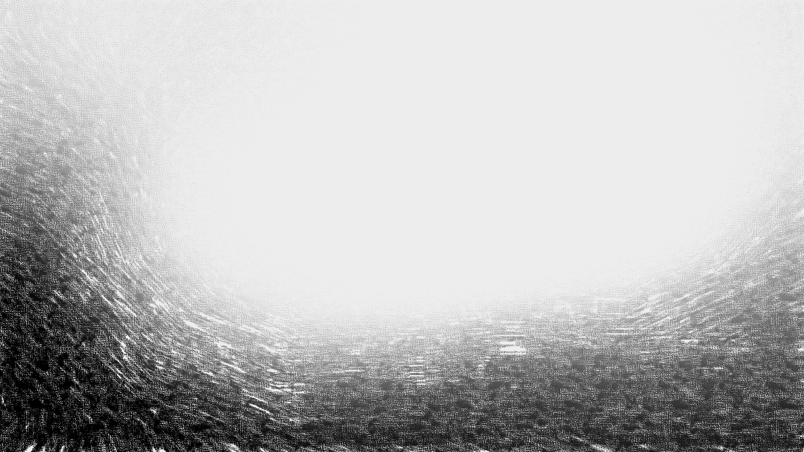
Flexible Associations:
Openness to Experience and Network Structure of Semantic Memory
Alexander Christensen Thesis Proposal

Slide 2
Structure of Semantic Memory
Collins and Quillian (1969) set the foundation for semantic memory being hierarchically organized
Collins and Loftus (1975) put forth spreading activation, which affects the efficiency of search and the associations available in semantic memory
Collins and colleagues laid the groundwork for semantic memory being structured as a network of hierarchical connections between associations
In semantic networks, nodes are typically represented by concepts or words
Connections (or “edges”) are unweighted, bidirectional relationships between two concepts

Slide 3
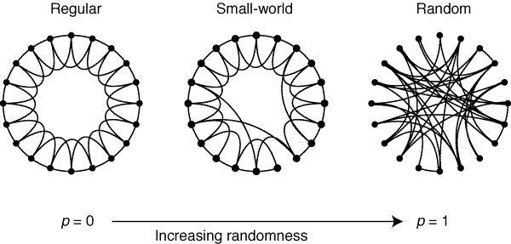

Network Measures
Average Shortest Path Length (ASPL): mean distance between any two nodes in the network
Clustering Coefficient (CC): probability that two neighbors of a node will be neighbors themselves
Small-worldness (S): small ASPL and large CC $S= \frac{ASPL (random)}{ASPL}− \frac{CC}{CC (regular)}$
Modularity (Q): measure of compartmentalized sections in the network known as network communities
Diameter (D): the length of the longest path in the network
Taken from Watts & Strogatz (1998)

Slide 4
Why should openness to experience be related to semantic memory?
Openness is dominated by cognitive functions: intelligence, working memory, autobiographical memory, implicit memory, insight problem solving, imagination, and creativity
Broad general knowledge: crystallized intelligence, curiosity, love of learning
Cognitive flexibility: divergent thinking, overcoming functional fixedness
Creative cognition: creative achievement, remote associates test (RAT), metaphor production, humor production

Slide 5
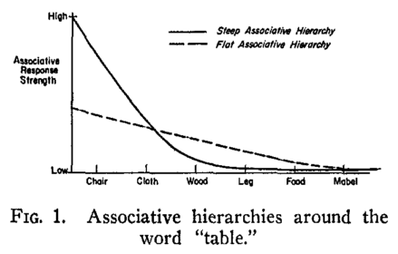
Associative Theory of Creativity
Creative people are able to reach more remote solutions by “flat” associative hierarchies (Mednick, 1962)
High associative strength (“steep” hierarchy)
reduces the probability of getting to more
remote associations and produces fewer, more
stereotypical relations
Evidence of this is seen in a study by
Kenett, Anaki, and Faust (2014) who found highly
creative people have more unique associations to cue words than
people low in creativity
Taken from Mednick (1962)

Slide 6
Creativity and Semantic Networks
In the same Kenett et al. (2014) study, the authors used a semantic network technique to examine the structure of high and low creative groups
Groups were formed using scores from Raven’s Matrices, RAT, a metaphor comprehension task, and a battery of divergent thinking tasks
Kenett and colleagues found that the high creative of group had a more interconnected and flexible network than the low creative group
This evidence provides direct support for Mednick’s (1962) theory

Slide 7
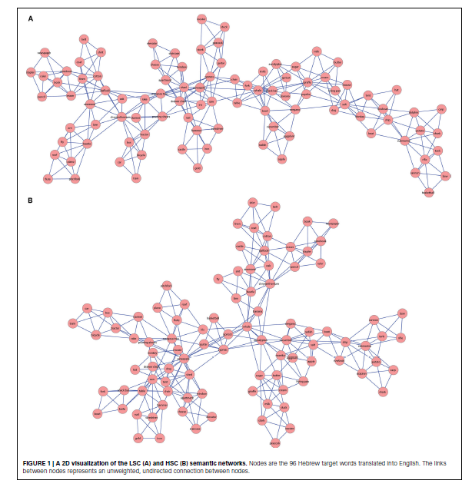
A: Low creative group
Larger ASPL
Smaller CC
Smaller S
Larger Q
Larger D
B: High creative group
Smaller ASPL
Larger CC
Larger S
Smaller Q
Smaller D
Taken from Kenett, Anaki, & Faust (2014)

Slide 8
Proposed Research
Based on openness’s associations with broad general knowledge, cognitive flexibility, and creativity, it’s expected that open people will differ in relation to their semantic structure
It’s also likely that open people will have more unique semantic associations because of their tendency toward novelty, learning, and knowledge

Slide 9
Proposed Method
About 200 people will be used from previously collected samples and 300 will be recruited from ongoing research for a total of 500
People will complete a measure of openness to experience using the NEO-FFI personality inventory (12 items)
People will also complete a measure of animal fluency (1 min.)
Based on standardized scores of openness, people will be split into three groups (n = 100 each; low, moderate, high) with 100 people separating each group

Slide 10
Proposed Analysis Plan
The network analysis will use the animal category exemplars generated from each of the three groups
Current methods require the same responses must be used across all groups when constructing the networks in order to compare them
Bootstrapped partial networks (1,000 iterations), using 50% of nodes, will be generated to statistically assess differences between groups (Kenett et al., 2013)
One-way ANOVA will be used to examine linear and quadratic effects for each network measure (ASPL, CC, S, Q, D)

Slide 11
Hypotheses
DV | Expected Effect (if any) | Interpretation
CC | none | none
ASPL | Negative | As openness increases, networks will become less spread out and more condensed suggesting increased interconnectivity between associations.
Q | Negative | As openness increases, networks will become less rigid and compartmentalized suggesting decreased categorization of groupings.
D | Negative | Networks will become more condensed as openness increases.
S | Positive | As openness increases, networks will be more clustered and have shorter path lengths, which suggests greater flexibility and efficiency between associations.

